Slide 1
Library System
Making it easy to search, manage, and explore books anytime.
Notes:
Noel start

Slide 2
01
Introduction
Notes:
Books have been with us since days of old and they served well in storing data and information of various things man have discovered and understood throughout the years. These books tend to be conglomerated in a repository building known as a library. People are usually free to roam within the halls of these kinds of building to search for various sources for them to read.
A ton of books get borrowed, used, and read in a library. a flood of books displaced from their dusty shelf homes. But how would they be returned to where they came from if a library’s repository is as big as a man’s home? The Dewey classification system. By the use of this management system, returning books and locating them is an ease.
We have around 700 students, more or less, in the institution which may or may not use the library for their leisure, studies, or rest. This number may potentially come to find resources for their studies along with the faculty staff and visitors coming by on our library.
This project is directly aimed at our local school library – the Batanes state College library. With their loss of their previous system’s functionality, they have returned to a more arbitrary manner of storing, fetching and collecting data through file cabinets, paper-based library cards, and manual file searching.

Slide 3
Problem and Solution
Problem
Solution
The traditional Dewey Classification System is complex and underused due to the rise of the internet, leaving libraries less accessible. A previous digital catalog system aimed to address this but has since failed, forcing the library back to manual, inefficient methods.
Our modernized library system simplifies book searches by indexing collections, tracking availability, and pinpointing locations. It provides a user-friendly digital interface that ensures quick, accurate navigation, making library access easier and more efficient.
Notes:
There is a form of discipline librarians use to identify the location of books and studies stored within the numerous shelves found within a library called the “Dewey classification system”. It uses a very specific way of classifying books and arranging them within the rows of different shelves. The issue is this knowledge is rarely dwelled upon due to the growth of the development of the world wide web which may serve as an alternative to these physical repositories of knowledge. Albeit the existence of this marvel, libraries worldwide are still used due to being more eye friendly given it does not emit various radiation to users and can last much longer given it does not need batteries to operate. To answer the issue of having less people know of the manner of searching books effectively and efficiently, our predecessor students have devised a way to answer this dilemma by means of integrating a digital system which catalogs the books stored within our local library then displays its location for easier pinpointing. Apparently, over the years, their system somewhat ceased to function properly leaving the library to return to their old problem.
To aid in their dilemma, we took the opportunity to remake their system and make it our own making it modern and more focused on the users rather than the admins. The system catalogs the entire number of books in the library, indexes each of these books and displays it all within the bounds of the library computer’s screen. It can update statuses of each book whether it is available, borrowed or disposed of and locate which isle and shelf it is on. It will start by weaving through the indexes in the database to try and find a similar result for the given search and if there are any that matches the query, it will start to locate it within the library based on the given data in the database.

Slide 4
Objective of the System
General Objectives
The system aims to improve quality of life in the Library.
The system aims to improve the management of the books in the Library
Specific Objectives
The system aims to guide library goers to find their desired books with ease and efficiency
The system aims to guide library goers and libraryians about the status of the book whether available, borrowed, or missing.
The system aims to unify registration and system with the catalog in order to ease the efforts of cluttering program changes

Slide 5
Requirement Analysis
Functional Requirements | None-Functional Requirements
Book/Topic finder – finds books within the database to pinpoint the location of the book in the library | Library Slides – display library facts, notices, and book advertisement after 2 minutes of inactivity, rotating every 15-60 seconds.
Digital book index – catalogs all books and displays it as a list in the system. | Theme – the system’s theme will follow either a library-like or a book-like theme.
Book Status Index – creates a status index for each book index in the database to determine if it is borrowed, dispose, or available. | Color Palette –features a harmonious blend of sky blue, aquamarine, and complementary blues paired with yellow.
Add, Edit-Update, and Delete functions - enables adding, editing and deleting book indexes in the database.
Minor Details Display – shows book genre, type, book code, location, status, and a short description if there are any availale.
Project Name: Library System
Project Developers: Noel Salazar
Christian Cantor Jean Marianne Elica Philippe Louis Garibay
Approved by:
Notes:
Next slide: pass to Christian Cantor

Slide 6
Software Feature Analysis
Book Finder: Simplifies locating books within the library through step-by-step guidance.
Digital Book Index: Offers a visual list of books with detailed information about each title.
Book Status Index: Tracks and displays the current status of books.
Admin Functions: Provides Level 2 and Level 3 admin users the ability to add, edit, and delete book entries.
Detailed Book Display: Highlights book details such as genre, location, status, and brief description for better user decision-making.
Library Slides: Transitions to an idle screen after 1 minute, showcasing library facts and book advertisements with slides changing every 15-60 seconds.
System Theme: Mirrors the library’s ambience with a cohesive and visually appealing design.
Color Palette: Utilizes a mis of sky blue, aquamarine, or similar blues alongside yellow.

Slide 7
02
Software Design

Slide 8
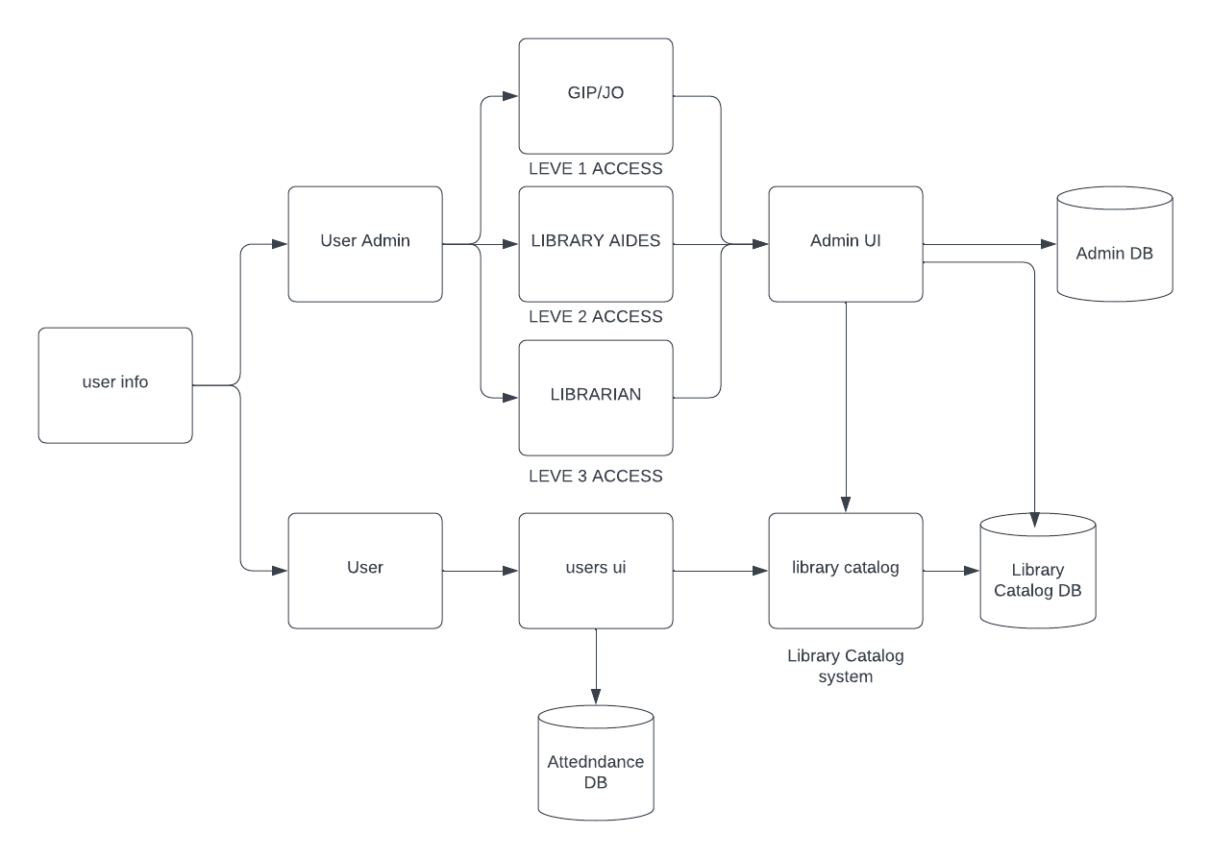
Software Architechtural Design
Notes:
Next slide pass to Noel Salazar

Slide 9
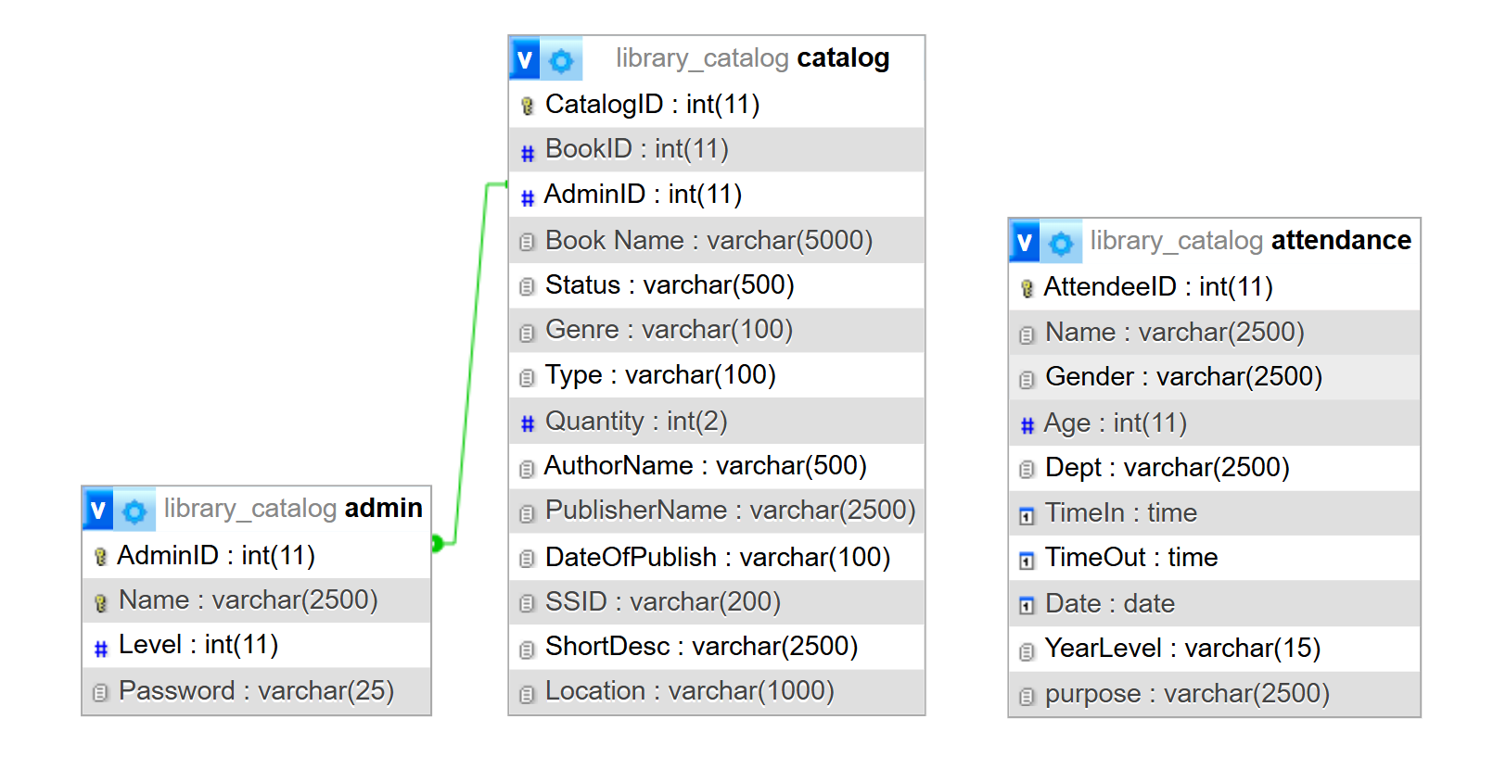
Database Design Document (ER Diagram)

Slide 10
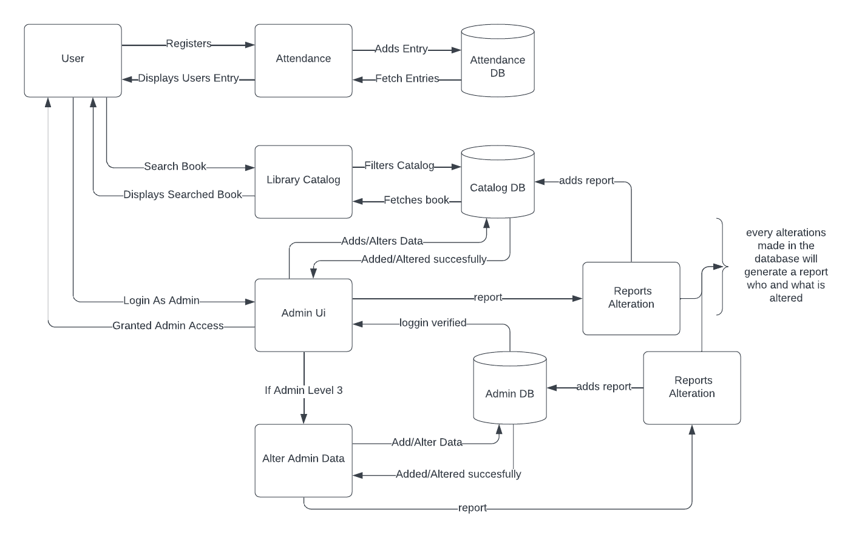
Data Flow Diagram

Slide 11
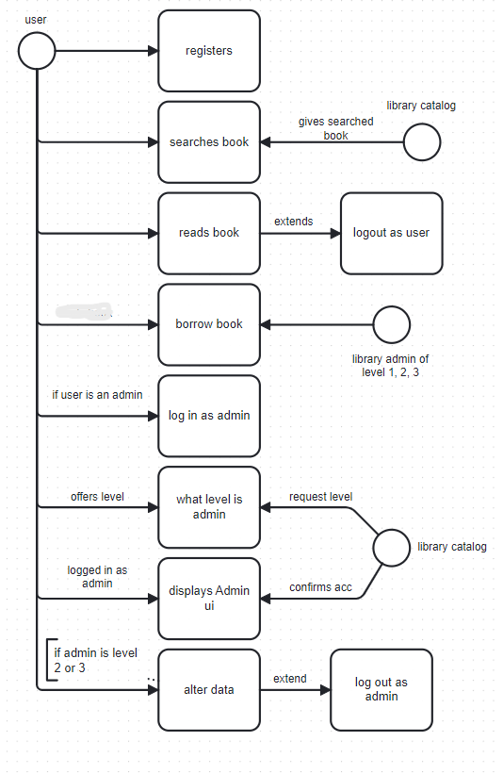
Use Case Diagram
Notes:
Next slide pass to Christian Cantor

Slide 12
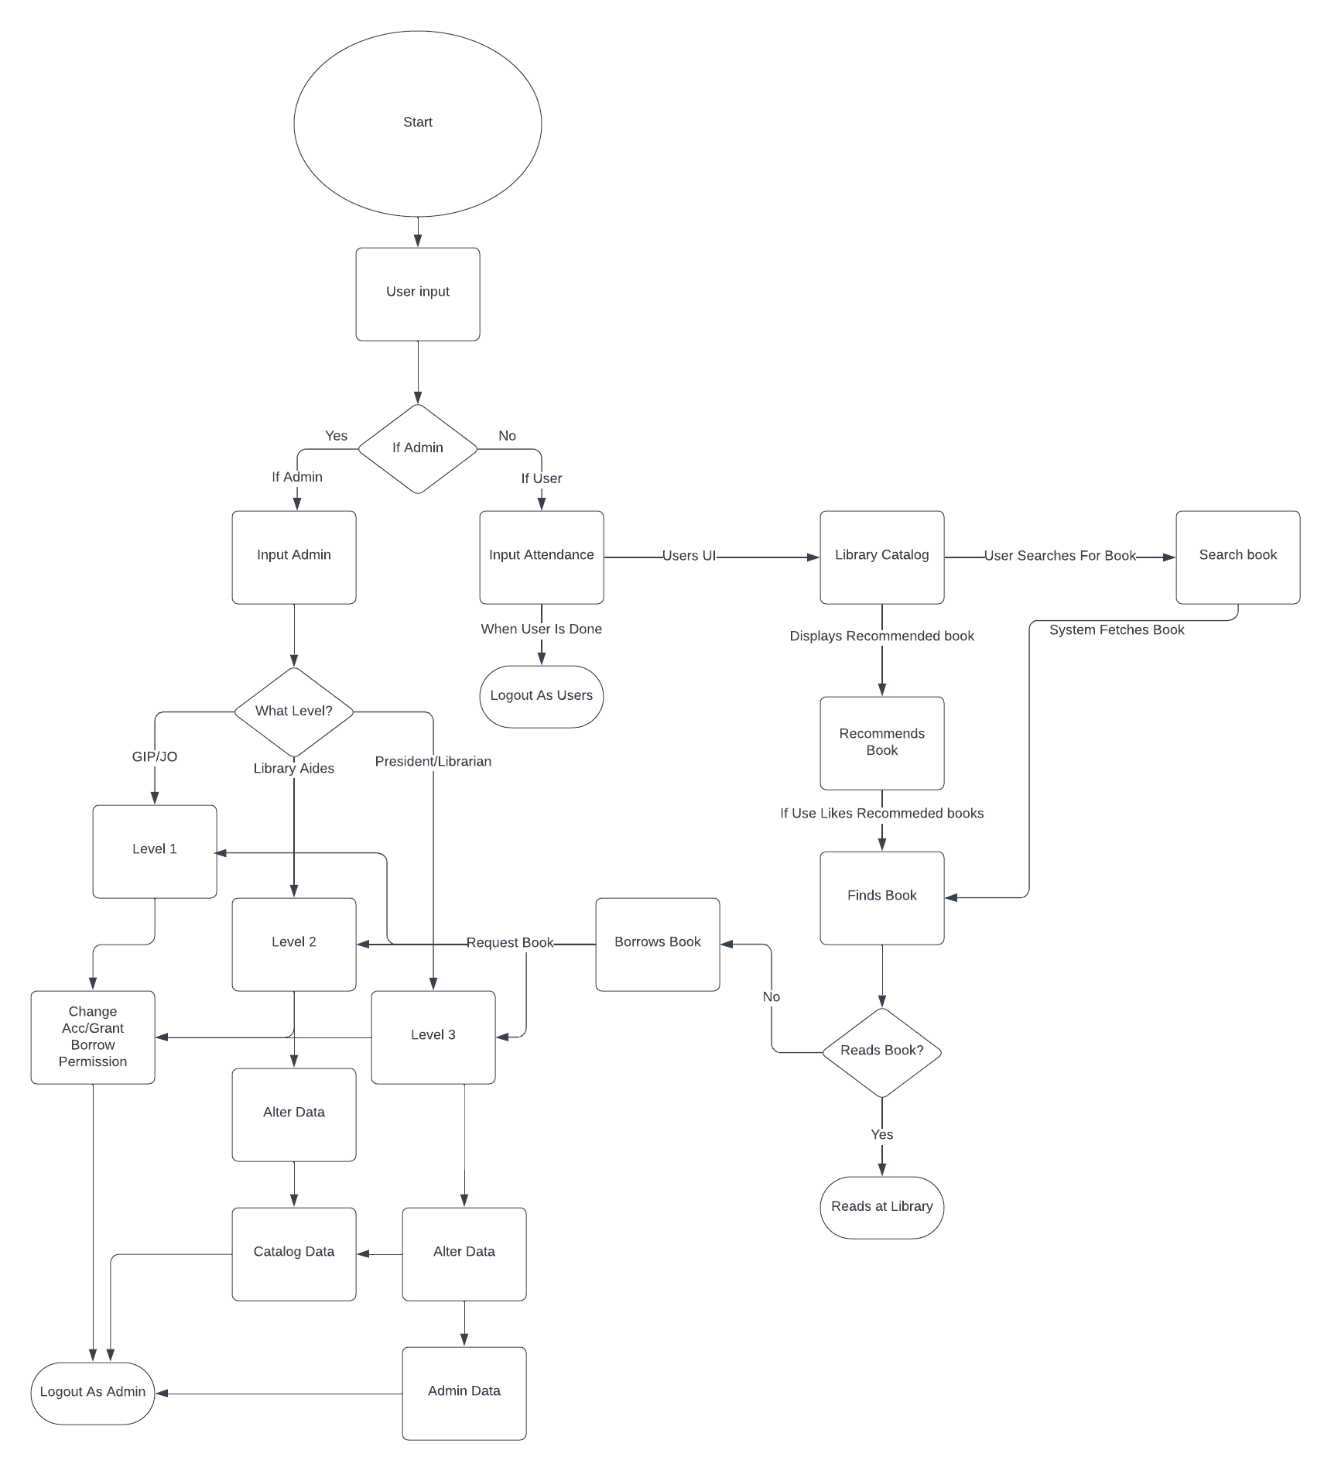
Program Flow Diagram
Notes:
Next slide pass to Jean Marianne Elica

Slide 13
User Interface

Slide 14
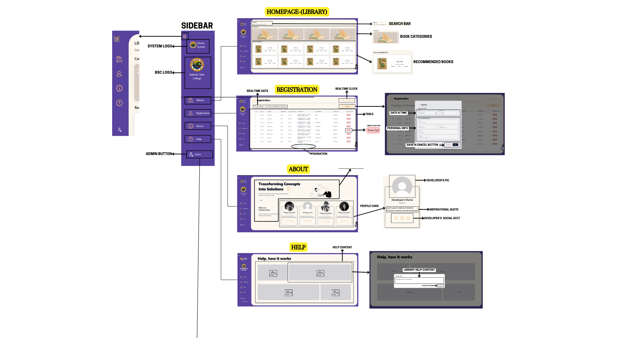

Slide 15
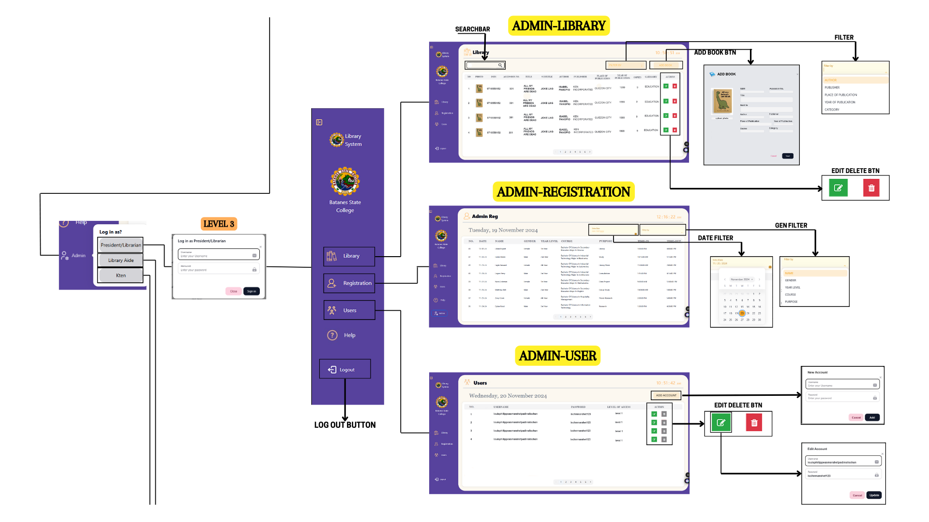

Slide 16
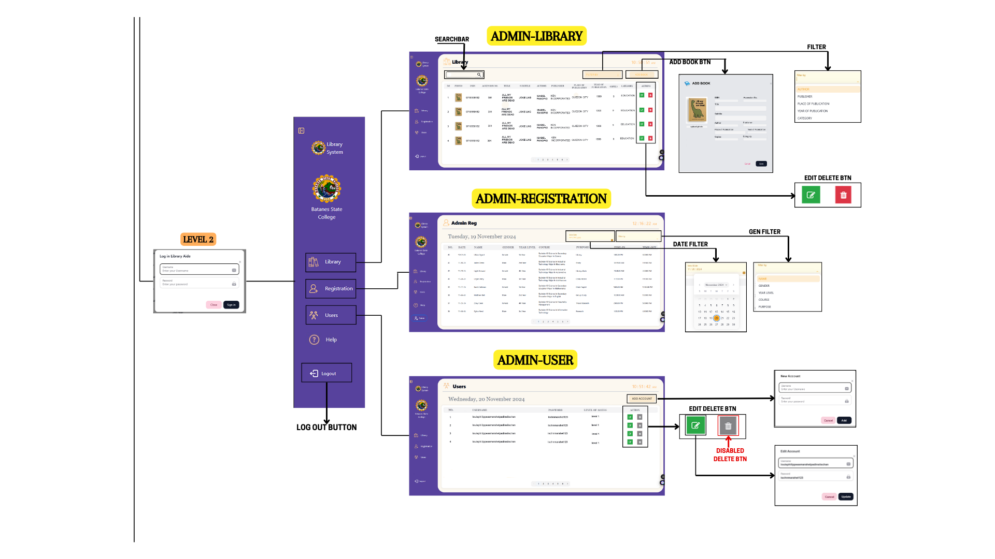

Slide 17
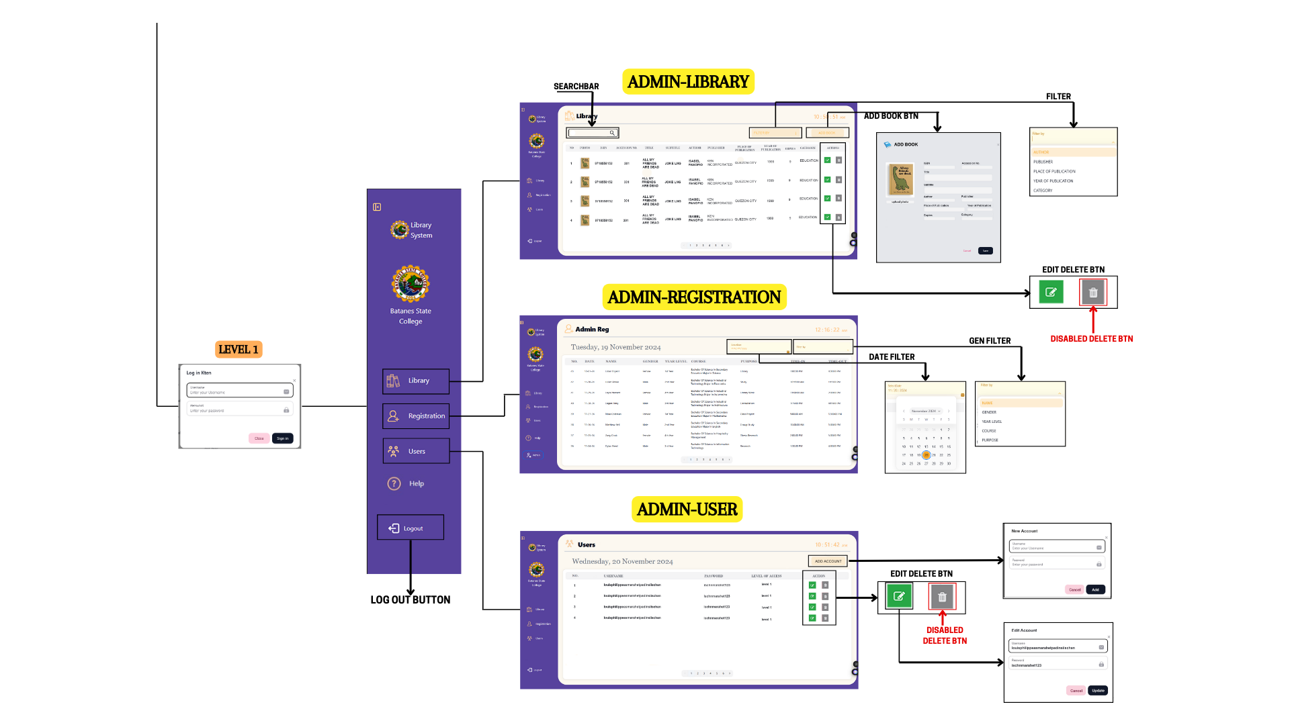
Notes:
Next slide pass to Philippe Garibay

Slide 18
Tools and Other Third-Party Components
Xampp
Next UI and Tailwind
We used xampp to set up local development environment, providing an easy-to-use platform for running the MySQL database. This is efficient data handling.
Tabler Icons
We used Next UI to quickly build a responsive and visually appealing interface with customizable components. It streamlined development by providing ready-to-use UI elements like modals and buttons. We also use Tailwind css for efficient styling.
We integrated Tabler Icons for clean and modern iconography, offering a wide variety of customizablle icons.

Slide 19
03
User Manual

Slide 20
Installation Manual
Install Xampp and run the application.
Put the API File (back-end database material) into this directory windows/user/htdocs
Set up the html/page file somewhere in your computer (on your desktop or on a folder)
Run html file in a web browser and begin using it.

Slide 21
Operational Manual
User Interface
Registration: Registers library goers for documentation purposes.
Library Catalog: allows users to search books and find their location, showing availability.
About and Help: Displays developers details, social media handles, and a user manual with wireframes.
Admin Log-in: enables login for different admin account levels (1, 2, or 3) requiring a password.
Admin Interface
Admin Account Managaement: Allows level 3 admins to manage other admin accounts.
Book Catalog Management: Enebles level 2 and 3 admins to modify the book catalog.
Book status Updating: Allows admins of all levels to update book statuses (borrowed, available, missing.)
Admin Logout: logs out the admin to return to the user interface.
About and Help: Provides developer details and the user manual with wireframes.
Idle Interface
Idle Screen: Appears after 2 minutes of inactivity, showing rotating library facts and book information.
Interface return: resumes the previous screen after user activity (key press, mouse move, or click.)

Slide 22
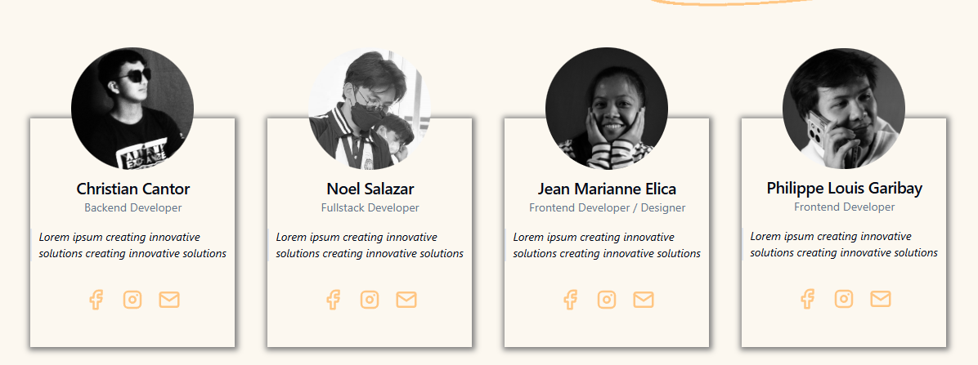
Developer Details

